Slide 1
Join
Join operations bring together two tables and combine their rows and columns in a specific fashion.
The generic join operator called the Theta Join is
It takes as arguments the columns from the two tables that are to be joined.
When the join condition operator is = then we call this an Equijoin
Dept of CSE, KUET

Slide 2
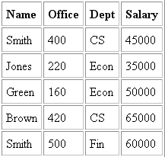
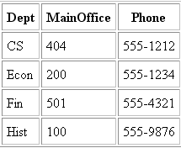
Join (continued)
Now, we have two tables Emp and depart.
We will play with these 2 tables for a while!
Dept of CSE, KUET

Slide 3
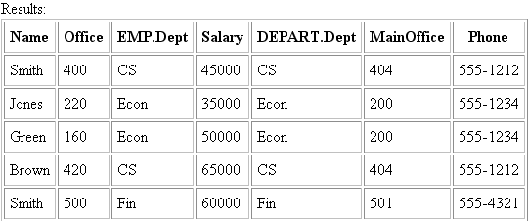
Join (continued)
Find all information on every employee including their department info
EMP _{emp.Dept = depart.Dept} DEPART
Dept of CSE, KUET

Slide 4
Join (continued)
Take a look, one table has 5 rows, the other has 4 rows, the resultant has 5 rows!
Dept of CSE, KUET

Slide 5
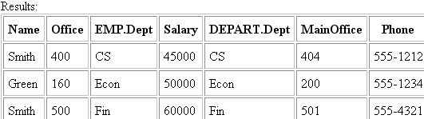
Join (continued)
Find all information on every employee including department info where the employee works in an office numbered less than the department main office
EMP (emp.office < depart.mainoffice) Λ (emp.dept = depart.dept) DEPART
Dept of CSE, KUET

Slide 6
Natural Join
Notice in the generic (Theta) join operation, any attributes in common (such as dept above) are repeated.
The Natural Join operation removes these duplicate attributes.
The natural join operator is: *
We can also assume using * that the join condition will be = on the two attributes in common.
Dept of CSE, KUET

Slide 7
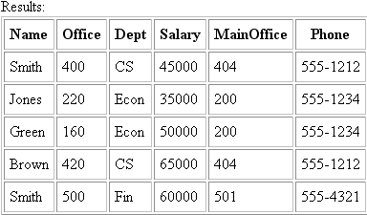
Natural Join (continued)
Emp * depart
There are 2 Dept columns, one is omitted!
Dept of CSE, KUET

Slide 8
Outer Join
In the Join operations so far, only those tuples from both relations that satisfy the join condition are included in the output relation.
The Outer join includes other rows as well according to a few rules.
Three types of outer joins:
Left Outer Join includes all rows in the left hand relation and includes only those matching rows from the right hand relation.
Right Outer Join includes all rows in the right hand relation and includes only those matching rows from the left hand relation.
Full Outer Join includes all rows in the left hand relation and from the right hand relation.
Dept of CSE, KUET

Slide 9
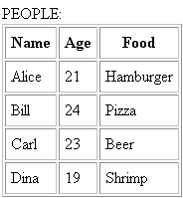
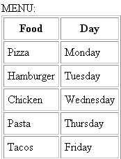
Outer Join (continued)
Now we have another 2 tables.
We will play with them for next few slides!
Dept of CSE, KUET

Slide 10
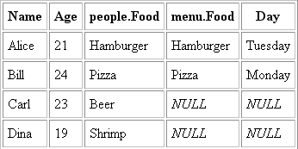
Left Outer Join
PEOPLE _{people.food = menu.food} MENU
Dept of CSE, KUET

Slide 11
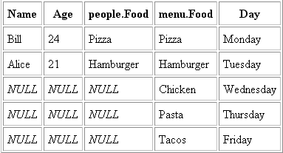
Right Outer Join
PEOPLE _{people.food = menu.food} MENU
Dept of CSE, KUET

Slide 12
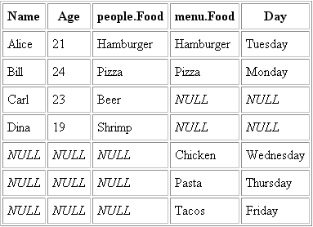
Full Outer Join
PEOPLE _{people.food = menu.food} MENU
Dept of CSE, KUET

